Slide 1


Daily CSI
Spot the Differences
Talk Time
8th Grade Forensic Science
T. Trimpe 2008 http://sciencespot.net/

Slide 2
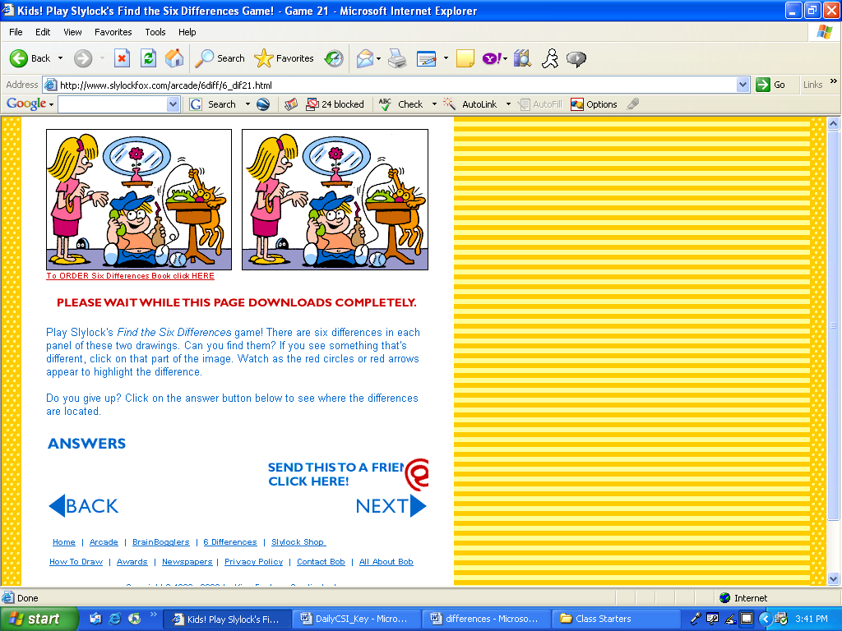
Find the 6 differences between the two pictures.
Source: http://www.slylockfox.com/arcade/6diff/index.html

Slide 3
The answers are …
Answers: Hair tie, mouse hole, table leg, phone, phone cord, missing watch band
Source: http://www.slylockfox.com/arcade/6diff/index.html

